Slide 1
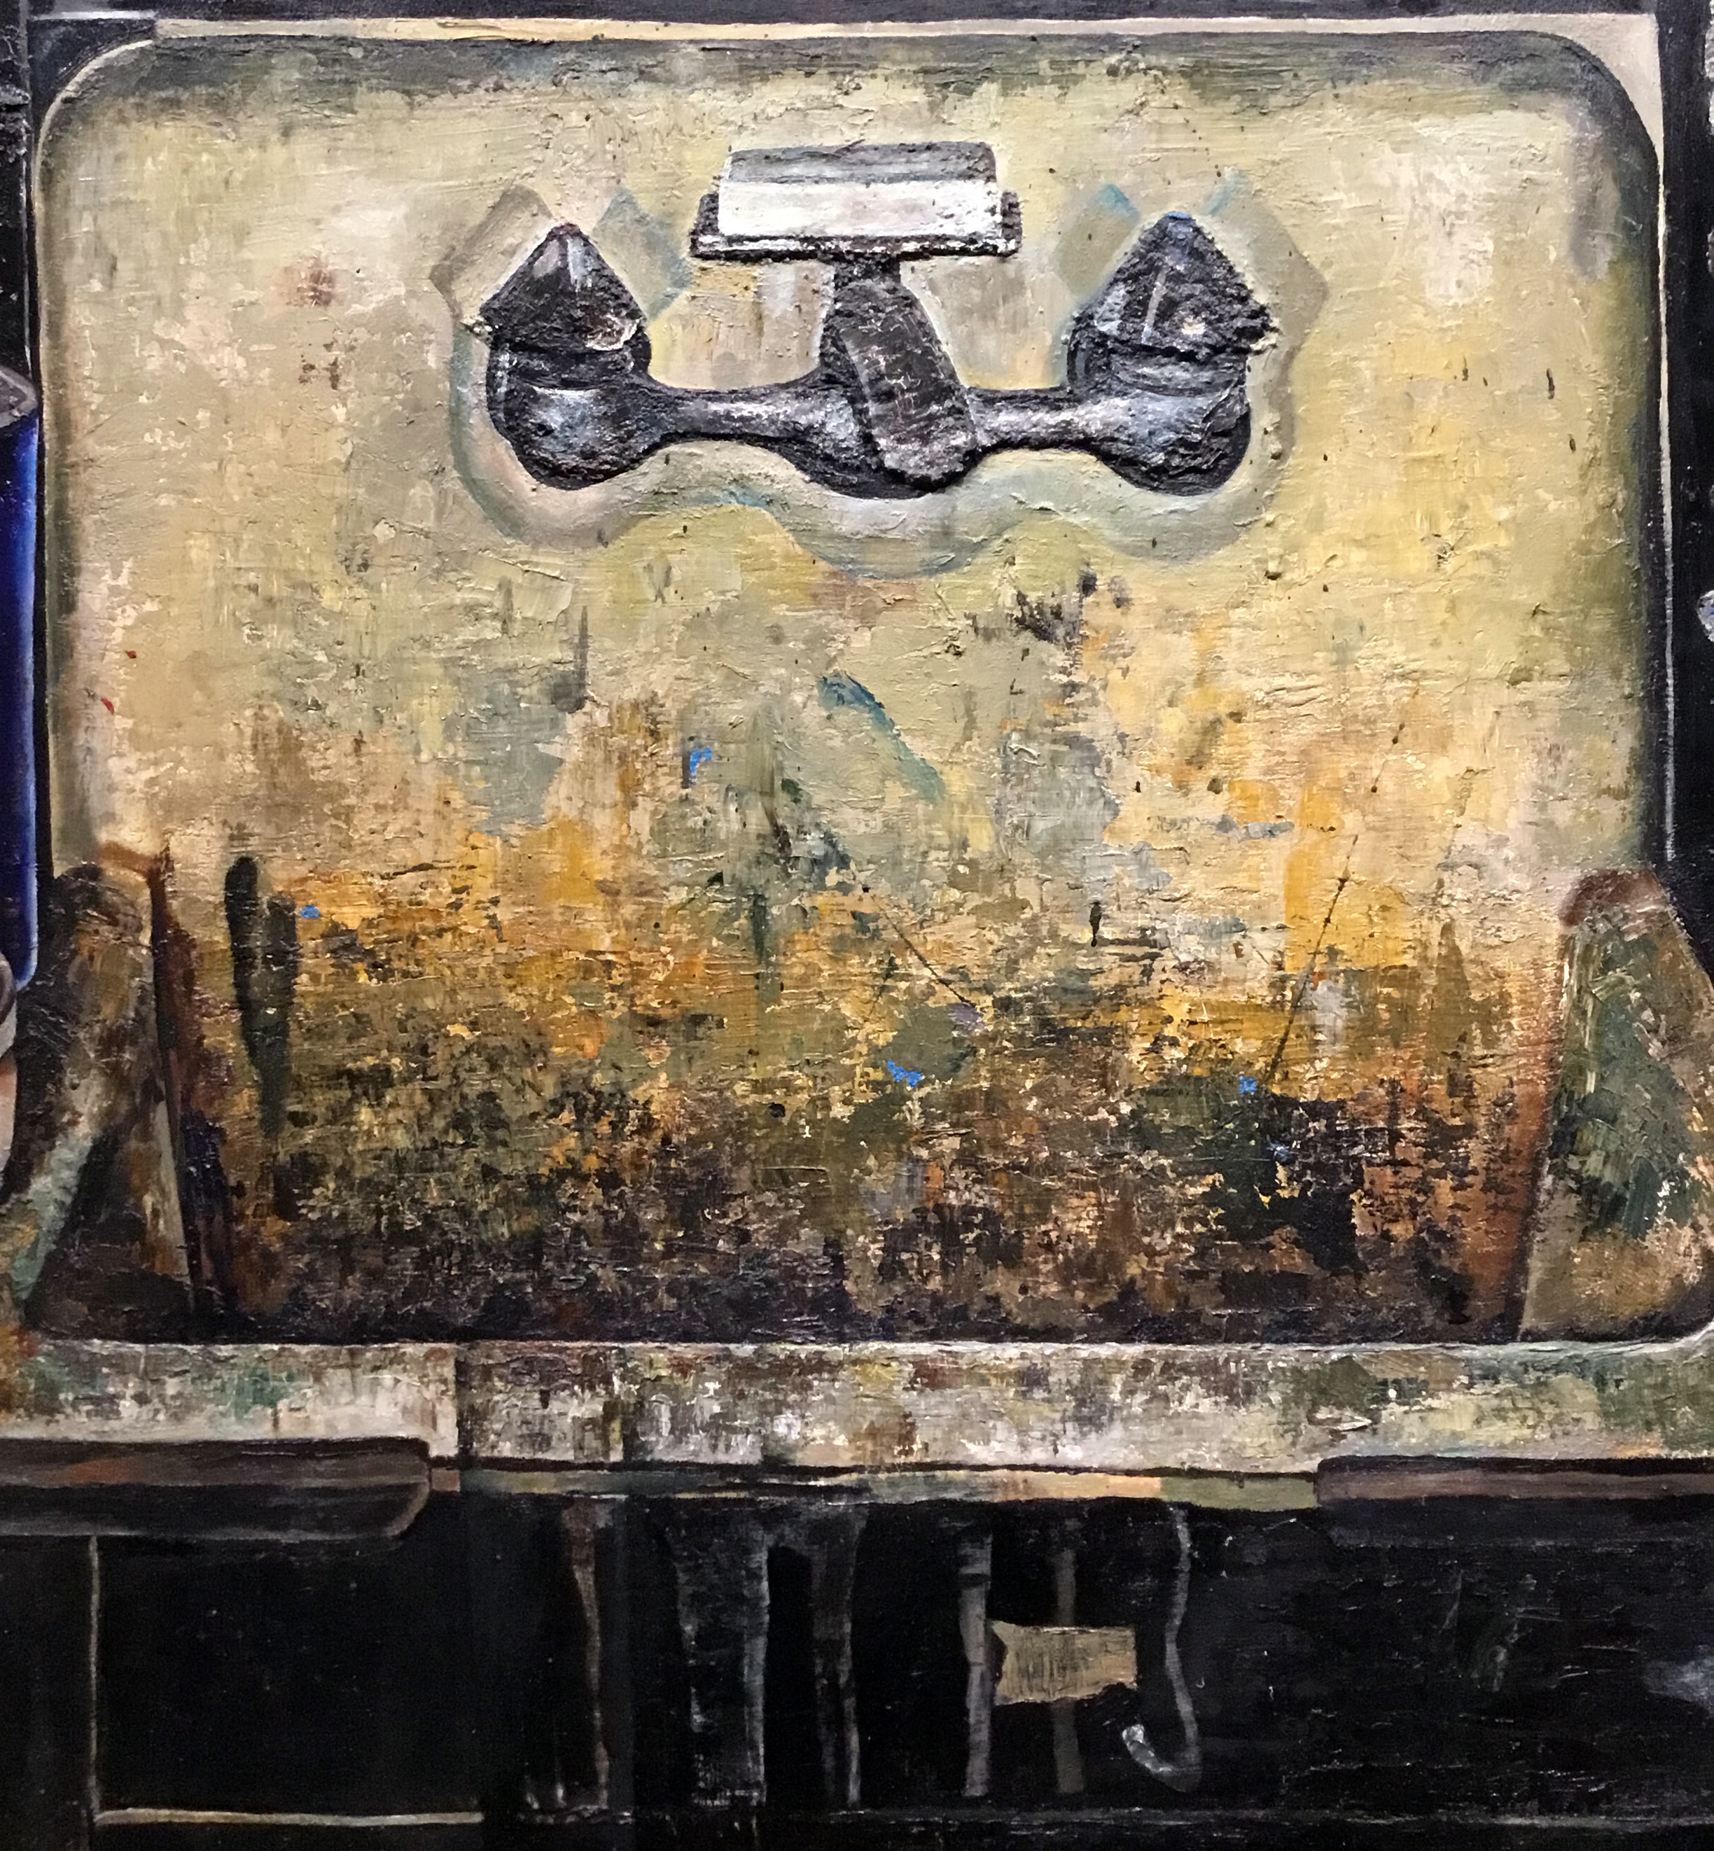
Paying Attention to Sinks and Such
Associate Teaching Professor Matthew Ballou

Slide 2
Notes:
Freud

Slide 3
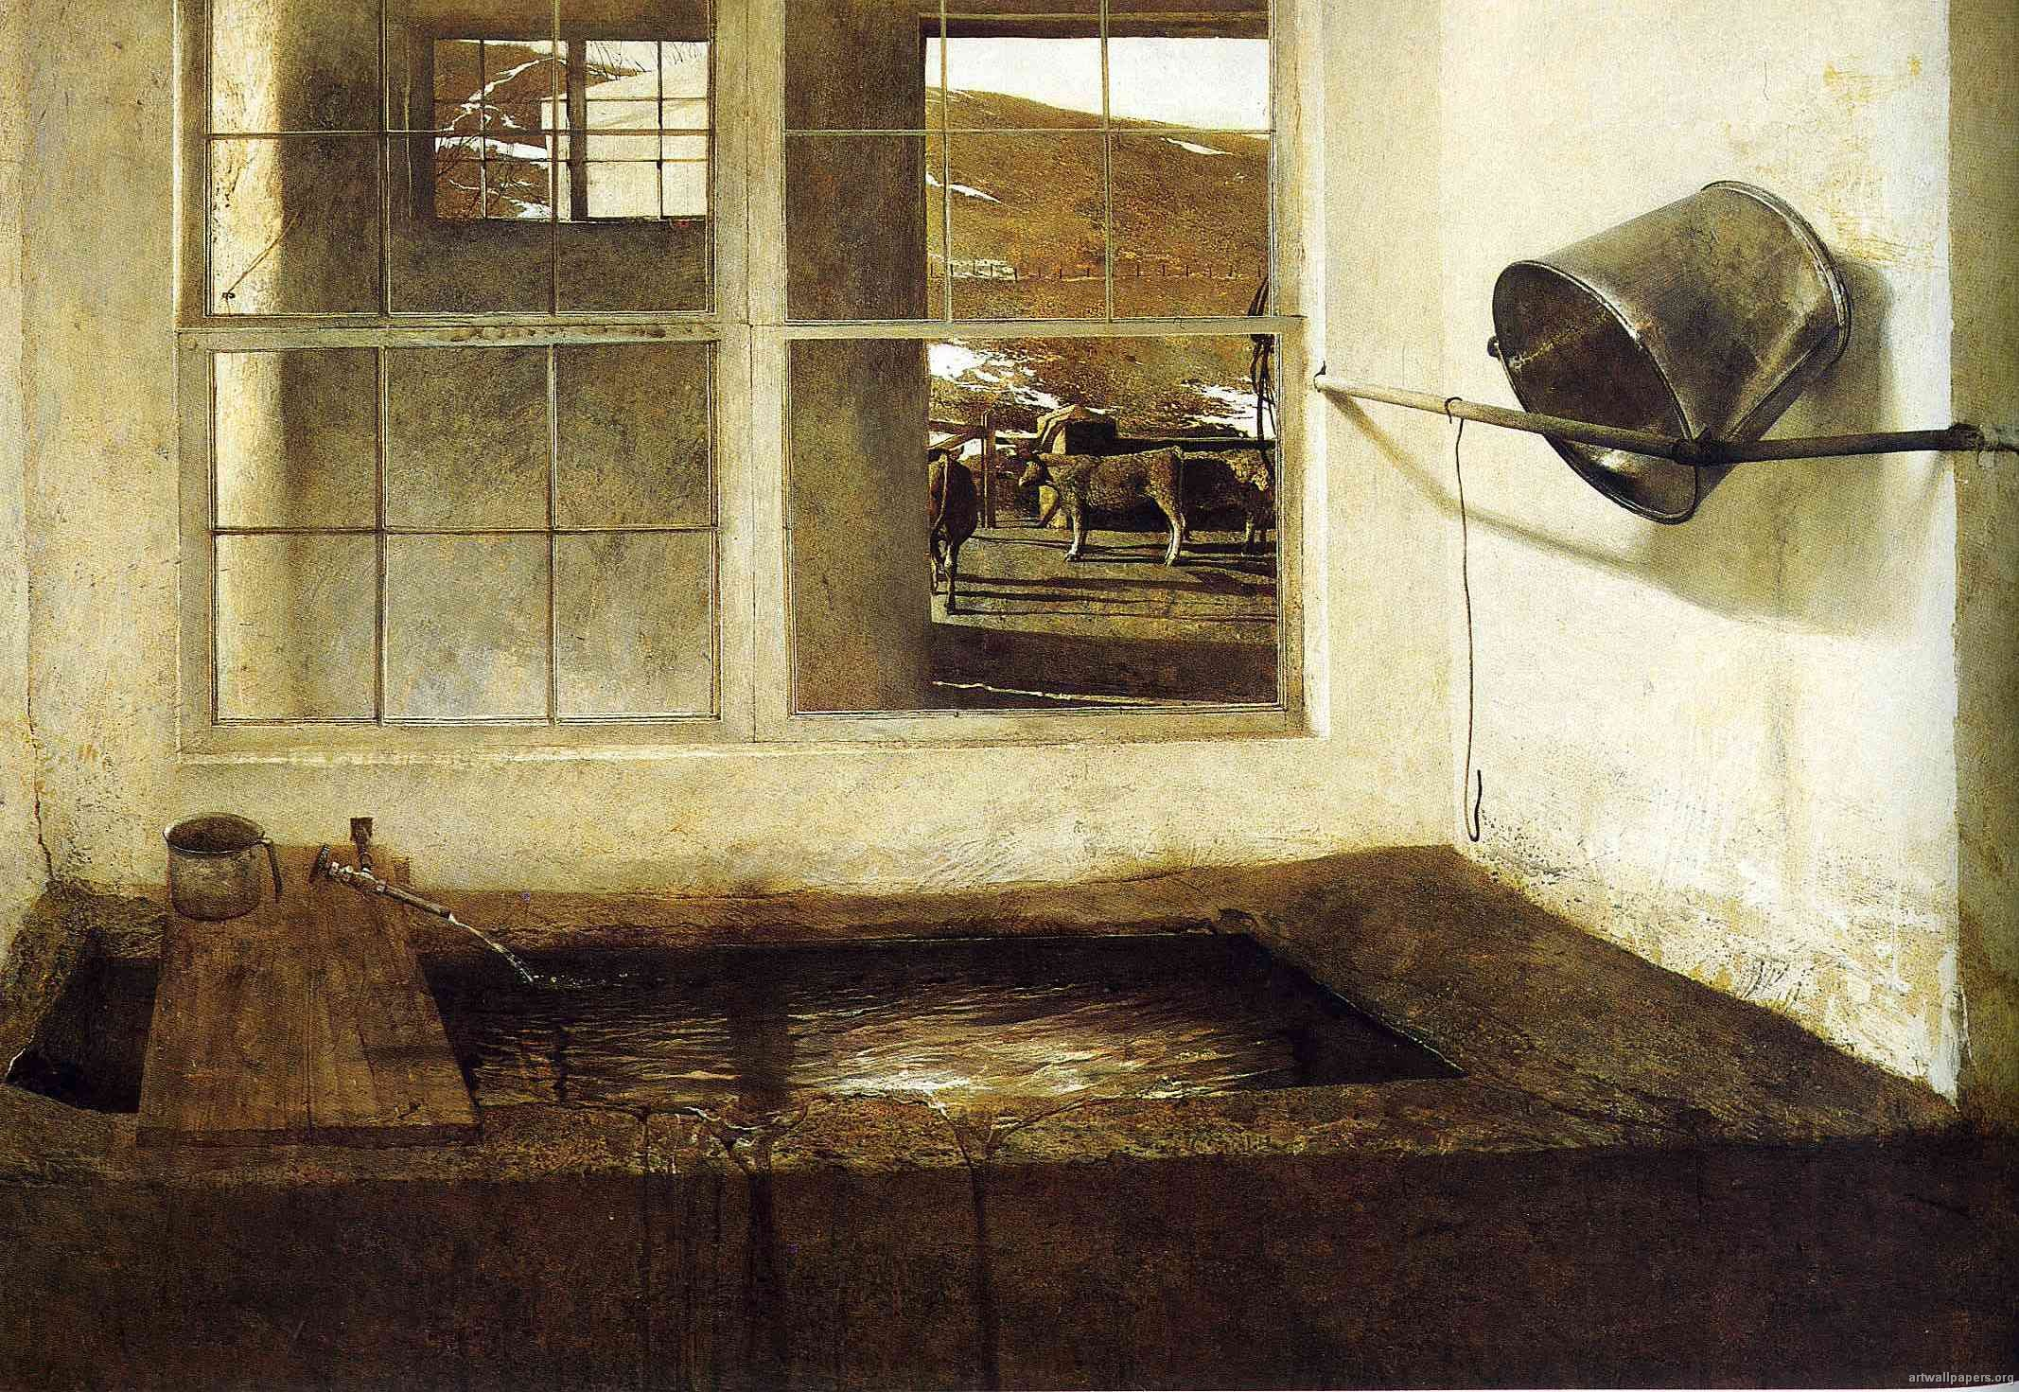
Wyeth – Spring Fed, 1968
Notes:
Wyeth

Slide 4
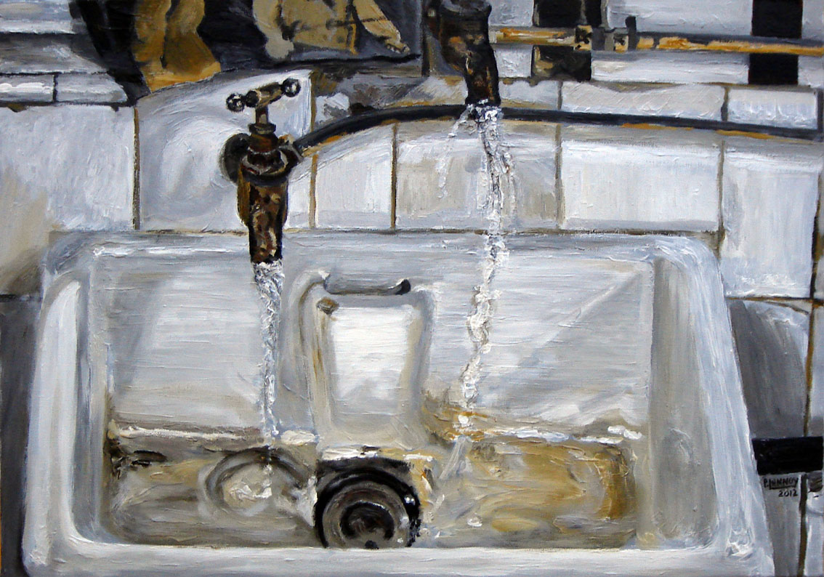
Lucian Freud - Two Japanese Wrestlers by a Sink, 1983
Notes:
Freud

Slide 5
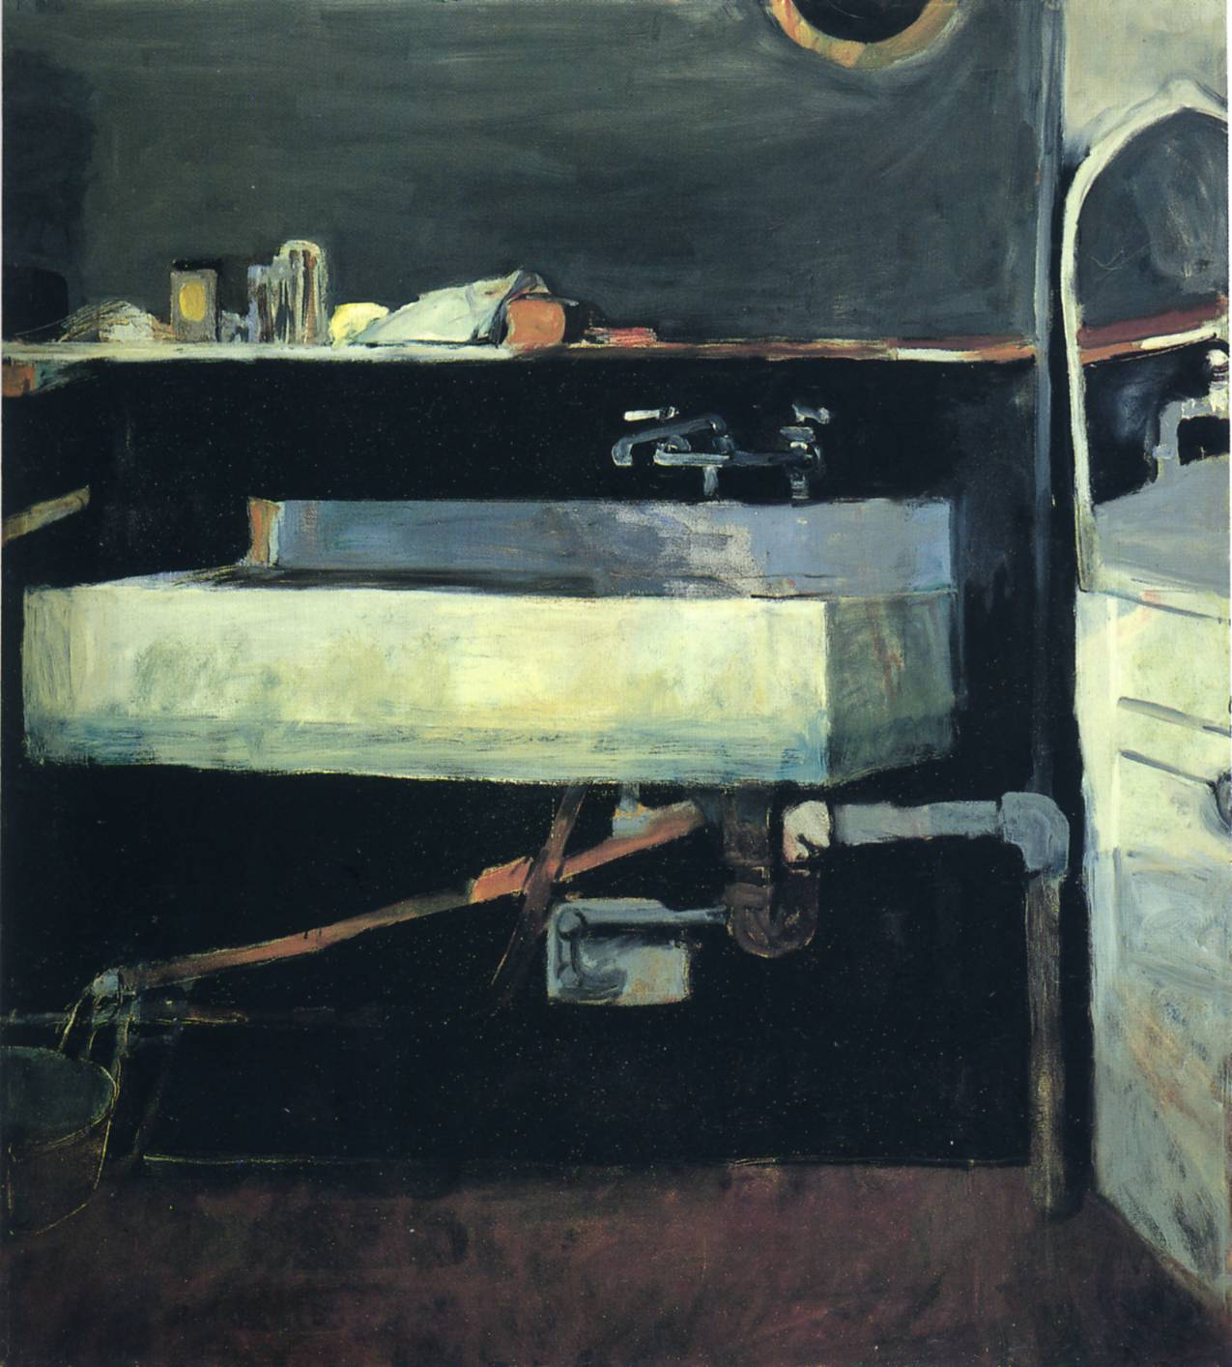
Diebenkorn – Corner of Studio, Sink, 1963)
Notes:
Diebenkorn

Slide 6
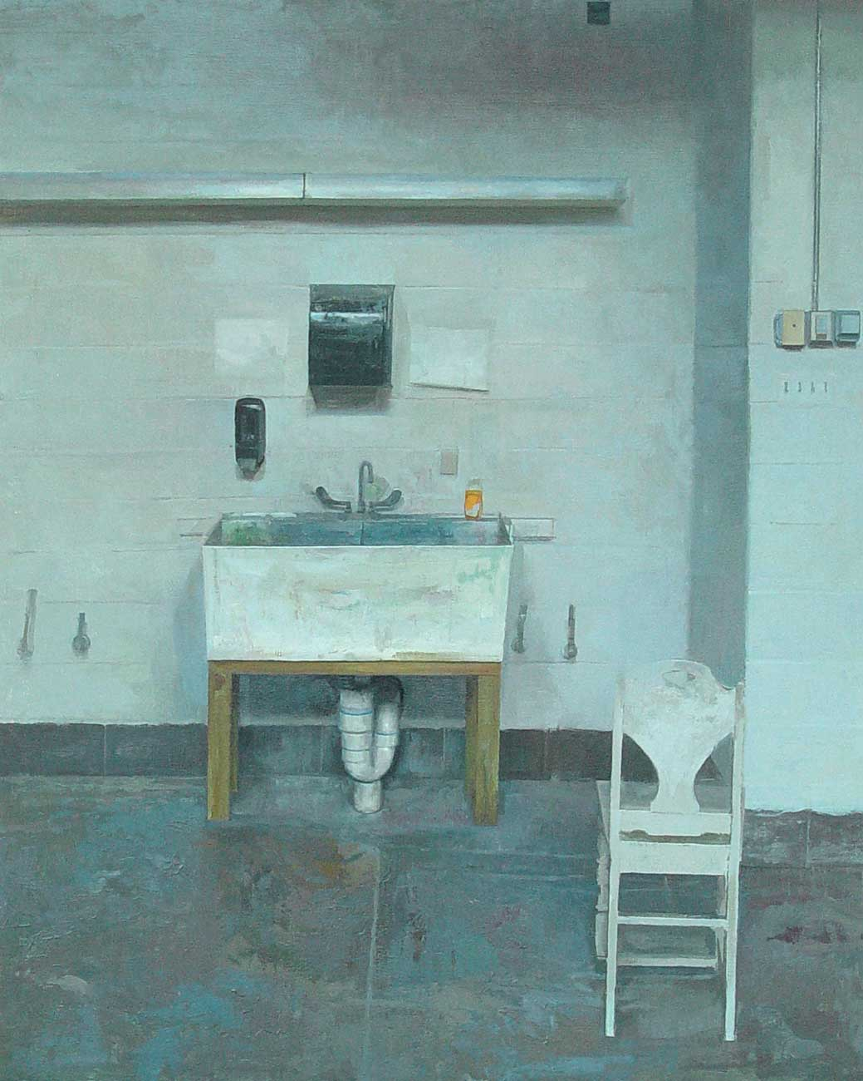
Matt Klos – Daylight Studio, 2004
Notes:
Matt Klos

Slide 7
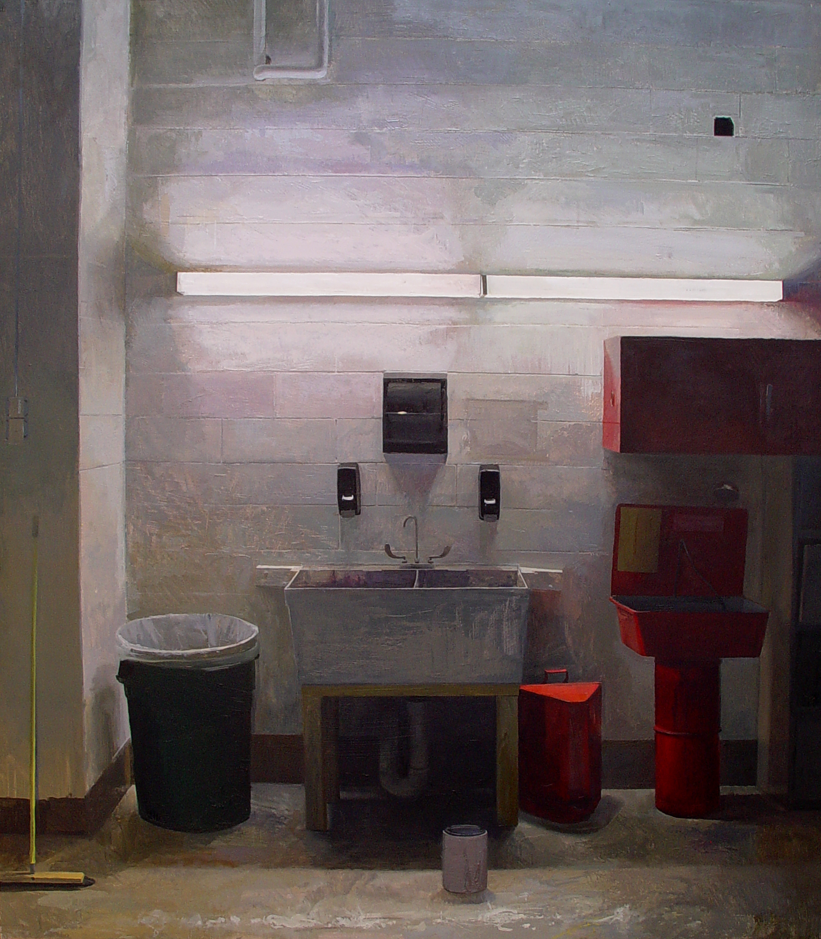
Matt Klos – Red Light, Green Light, 2002-2003
Notes:
Matt Klos

Slide 8
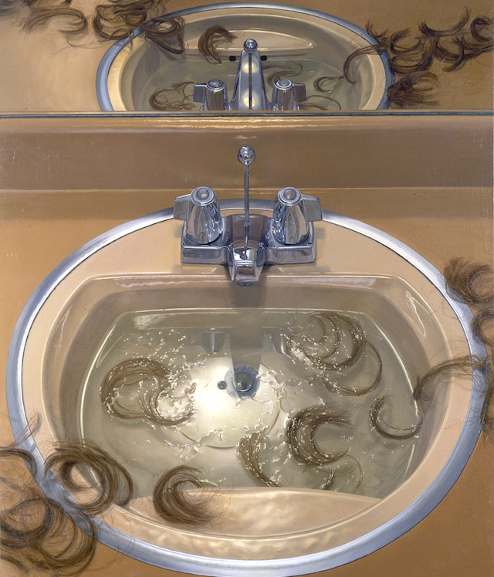
Catherine Murphy – Bathroom Sink and Mirror, 1994
Notes:
Catherine Murphy

Slide 9
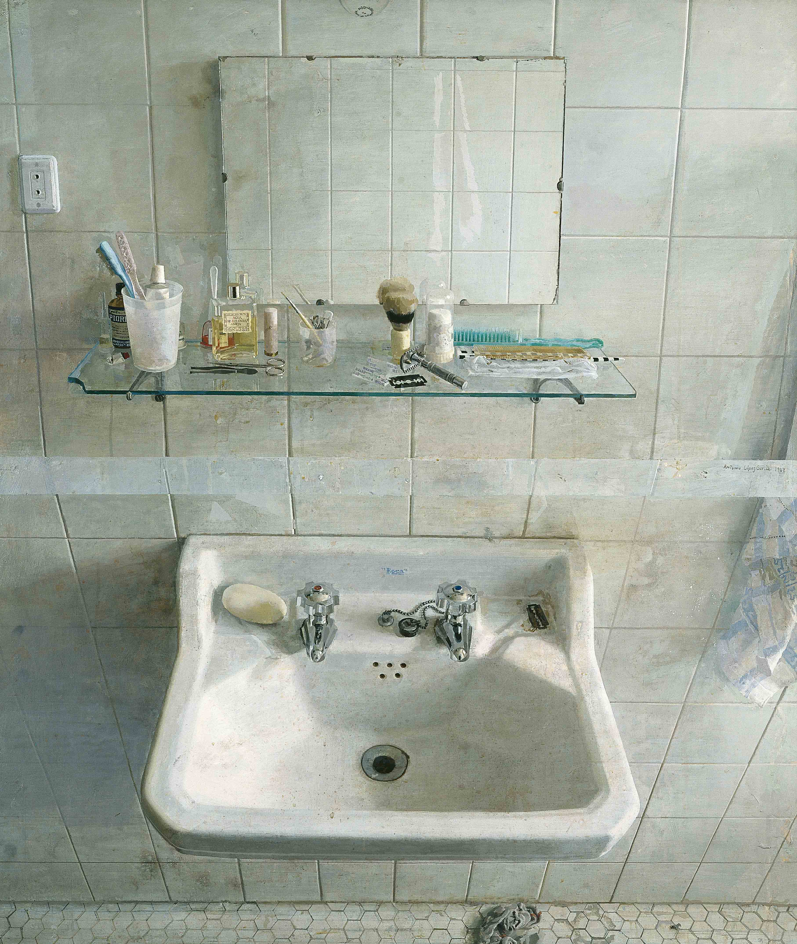
Antonio Lopez Garcia – Sink and Mirror, 1967
Notes:
Freud

Slide 10
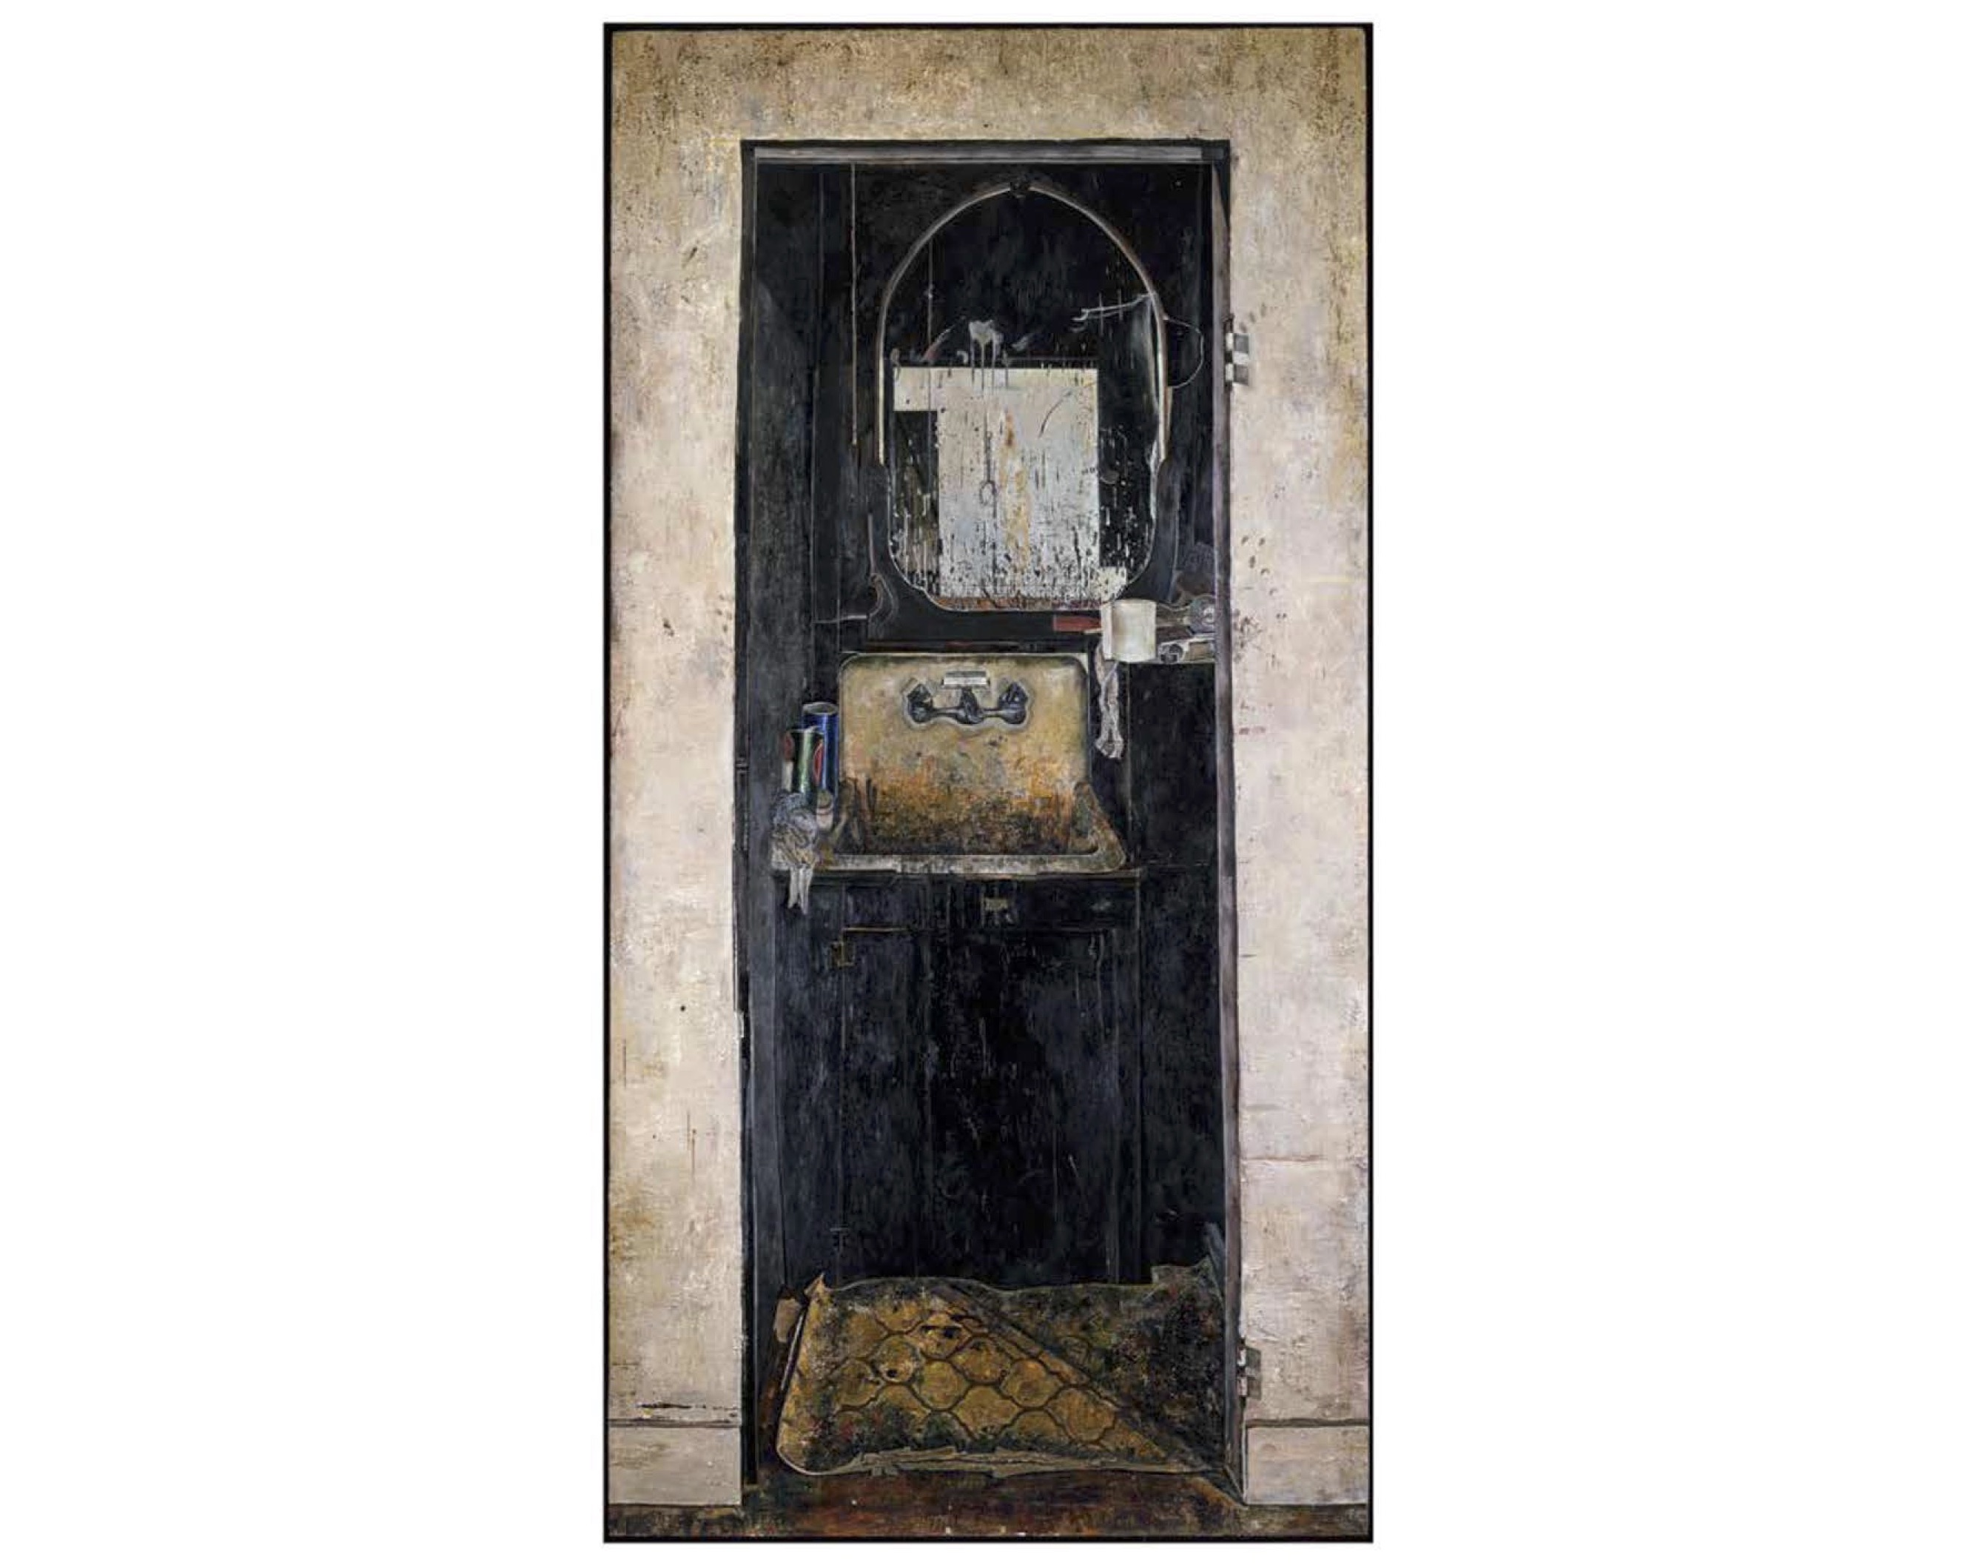
Dinnerstein - The Sink, 1974
Notes:
Freud

Slide 11
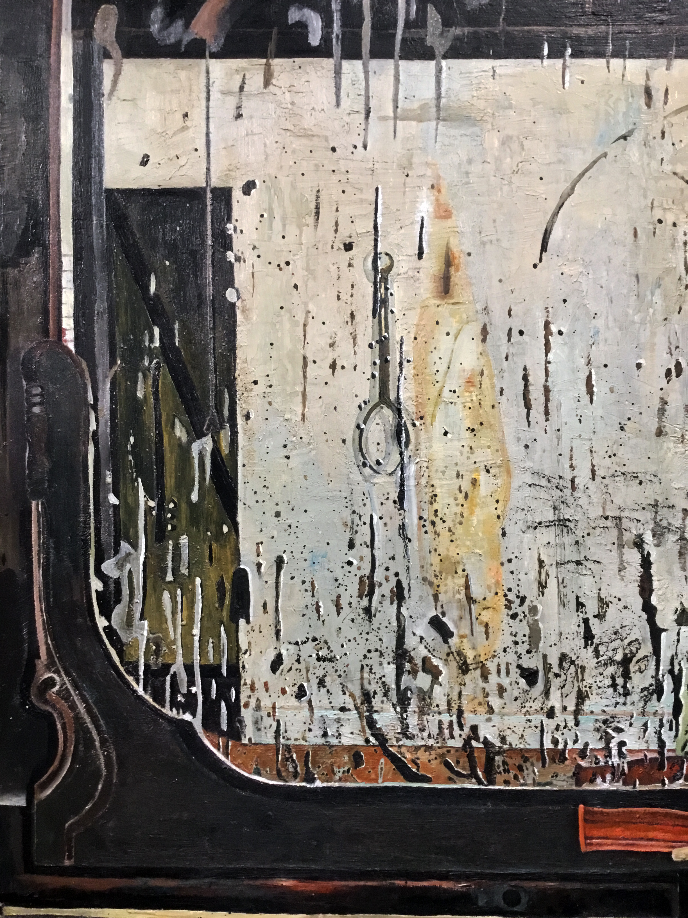
Notes:
Freud

Slide 12
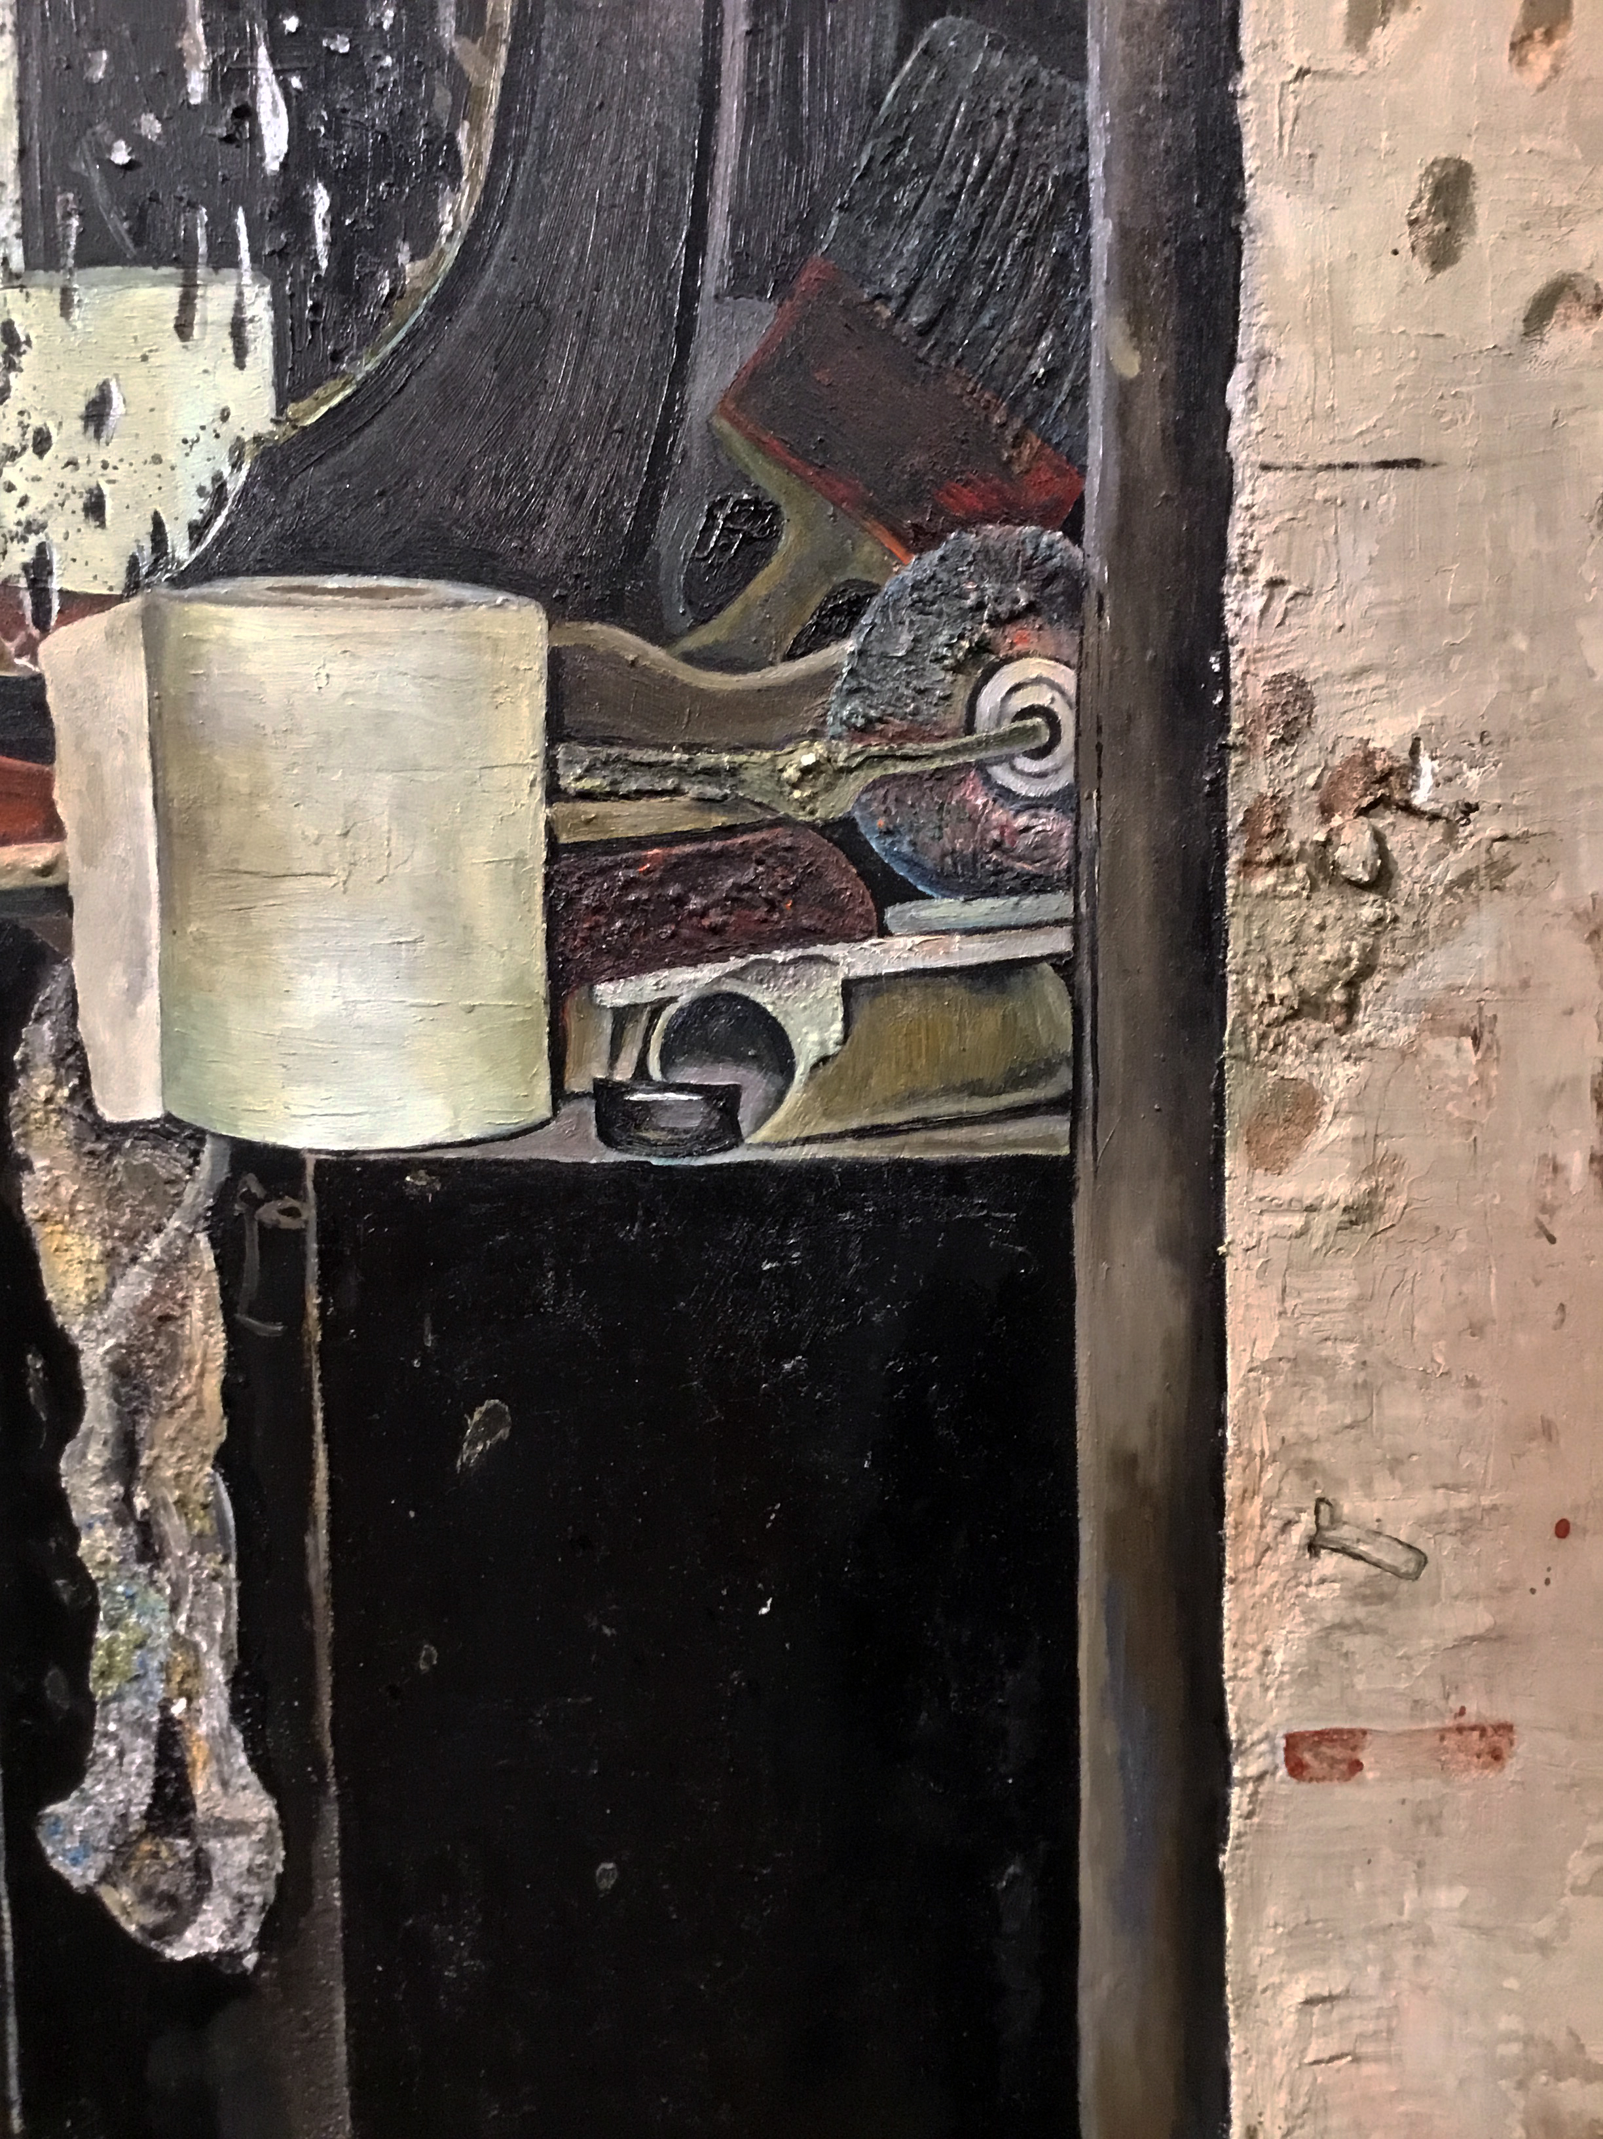
Notes:
Freud

Slide 13
Notes:
Freud

Slide 14
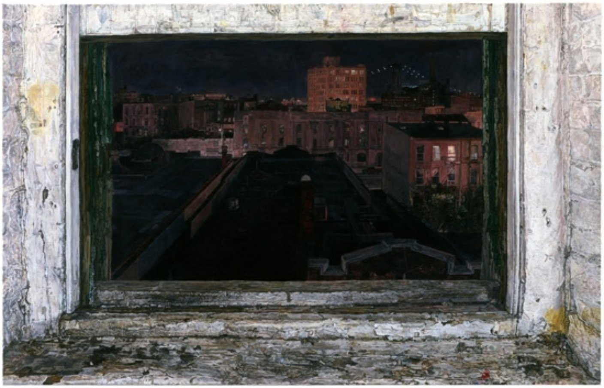
Ellen Altfest, Studio Window, 2003
Notes:
Ellen Altfest

Slide 15
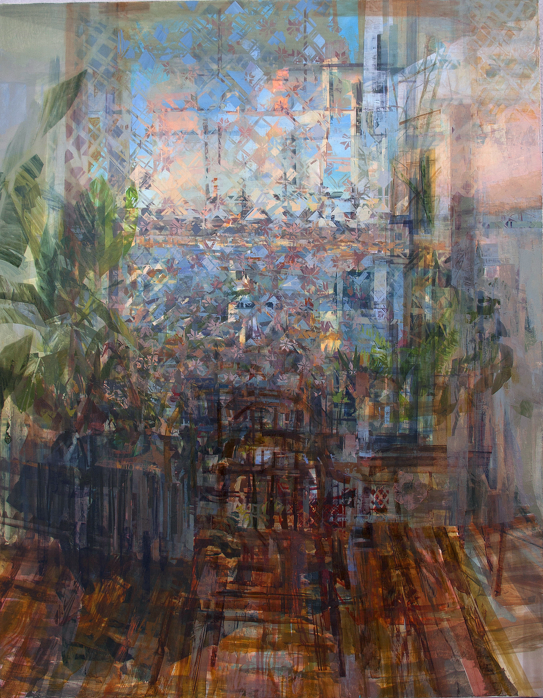
Stephanie Pierce – Untitled, 2016
Notes:
Stephanie Pierce

Slide 16
Notes:
Stephanie Pierce

Slide 17
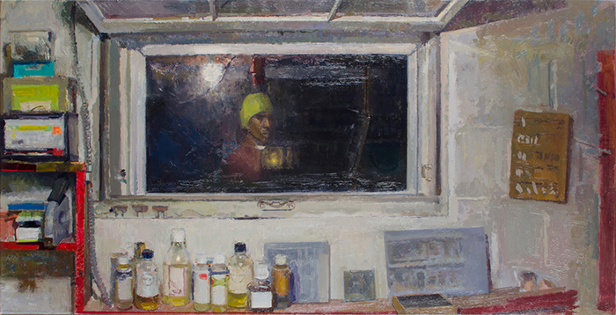
Matt Klos – Studio Window, 2014

Slide 18
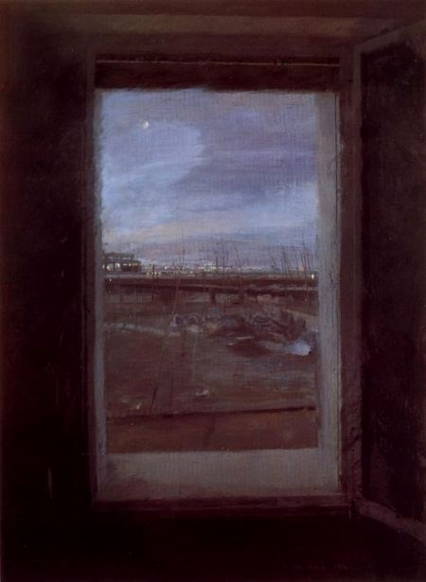
Antonio Lopez Garcia – Window 1, 1970
Notes:
Stephanie Pierce

Slide 19
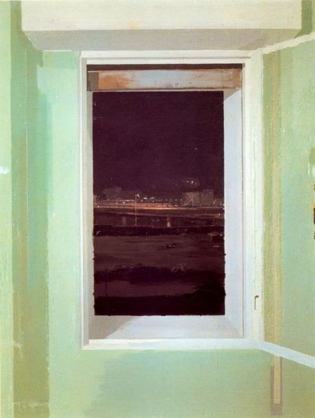
Antonio Lopez Garcia – Distant City at Night, 1980
Notes:
Stephanie Pierce

Slide 20
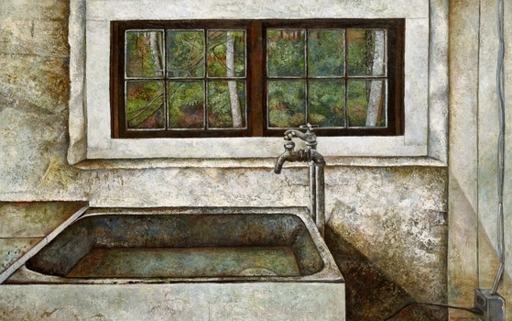
Dinnerstein – Alexander Studio Window, 1979
Notes:
Stephanie Pierce

Slide 21
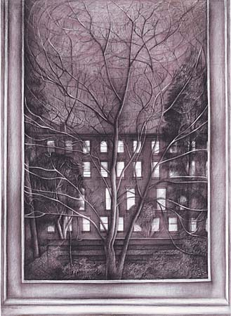
Dinnerstein – Night Scene 1, 1970
Notes:
Stephanie Pierce

Slide 22
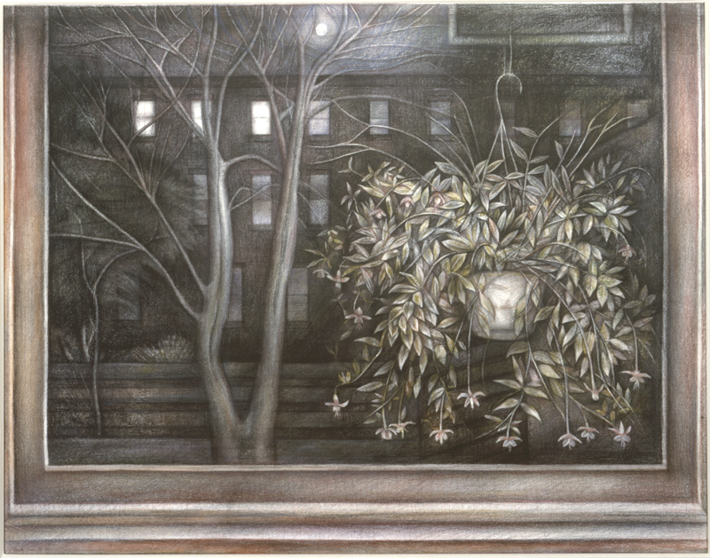
Dinnerstein – Night Scene 2, 1970
Notes:
Stephanie Pierce

Slide 23
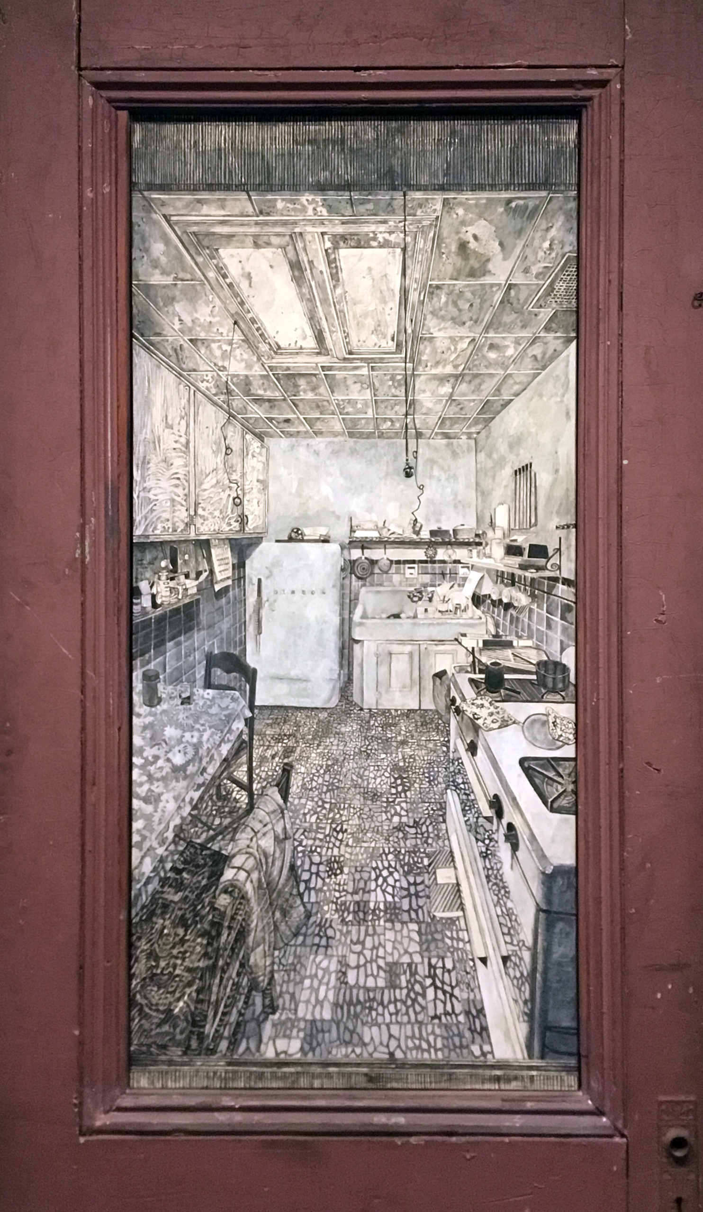
Dinnerstein – N’s Kitchen, 1970
Notes:
Stephanie Pierce

Slide 24
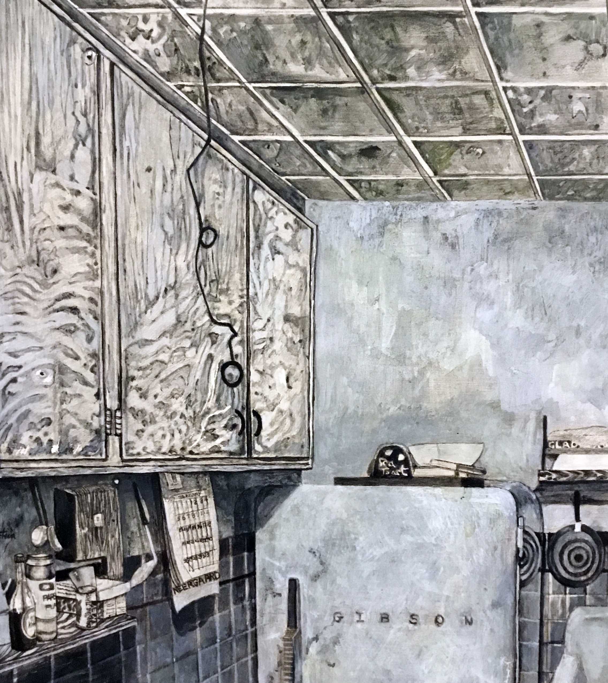
Notes:
Stephanie Pierce

Slide 25
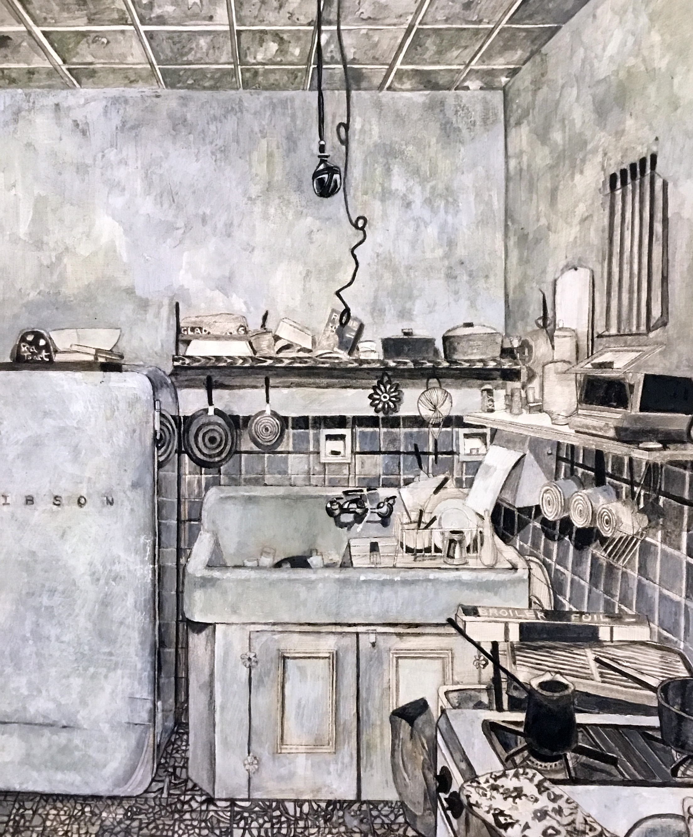
Notes:
Stephanie Pierce

Slide 26
A copy of this talk (slides and text) is available now at www.eikonktizo.wordpress.com
Associate Teaching Professor Matthew Ballou

